Slide 1

Quantum Mechanics
23PHY114
Lecture 5
Dr. Mrittunjoy Guha Majumdar
School of Artificial Intelligence, Amrita Vishwavidyapeetham Delhi NCR

Slide 2


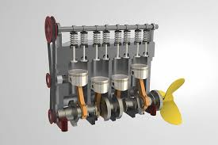
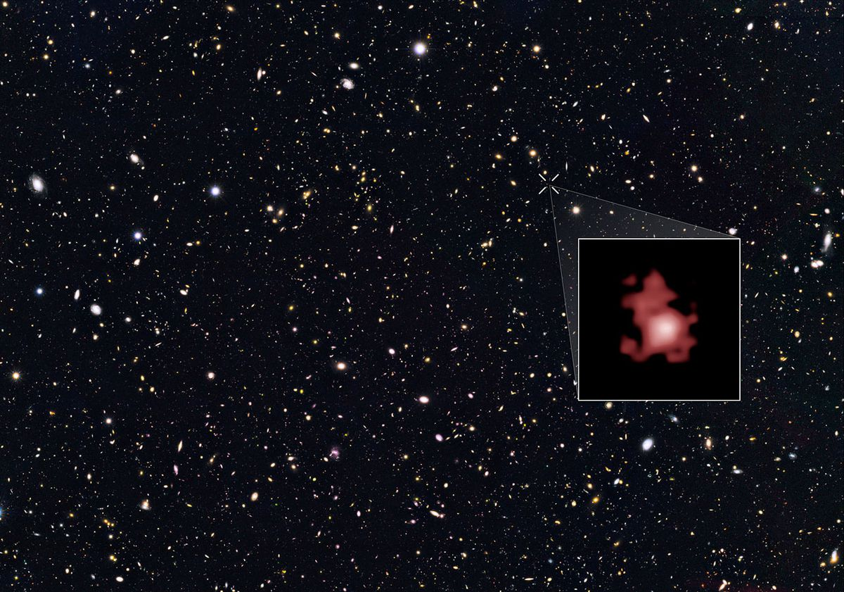

Oil Slick Iridescence
Interference and Refraction of Light
Downhill Rolling with Zorbs
Classical Mechanics, Friction and Gravity
Four-stroke Engine
Classical Thermodynamics
Classical Physics
But what if we study the Physics of bodies travelling at extremely high speeds or at the minutest of layers of reality?

Slide 3
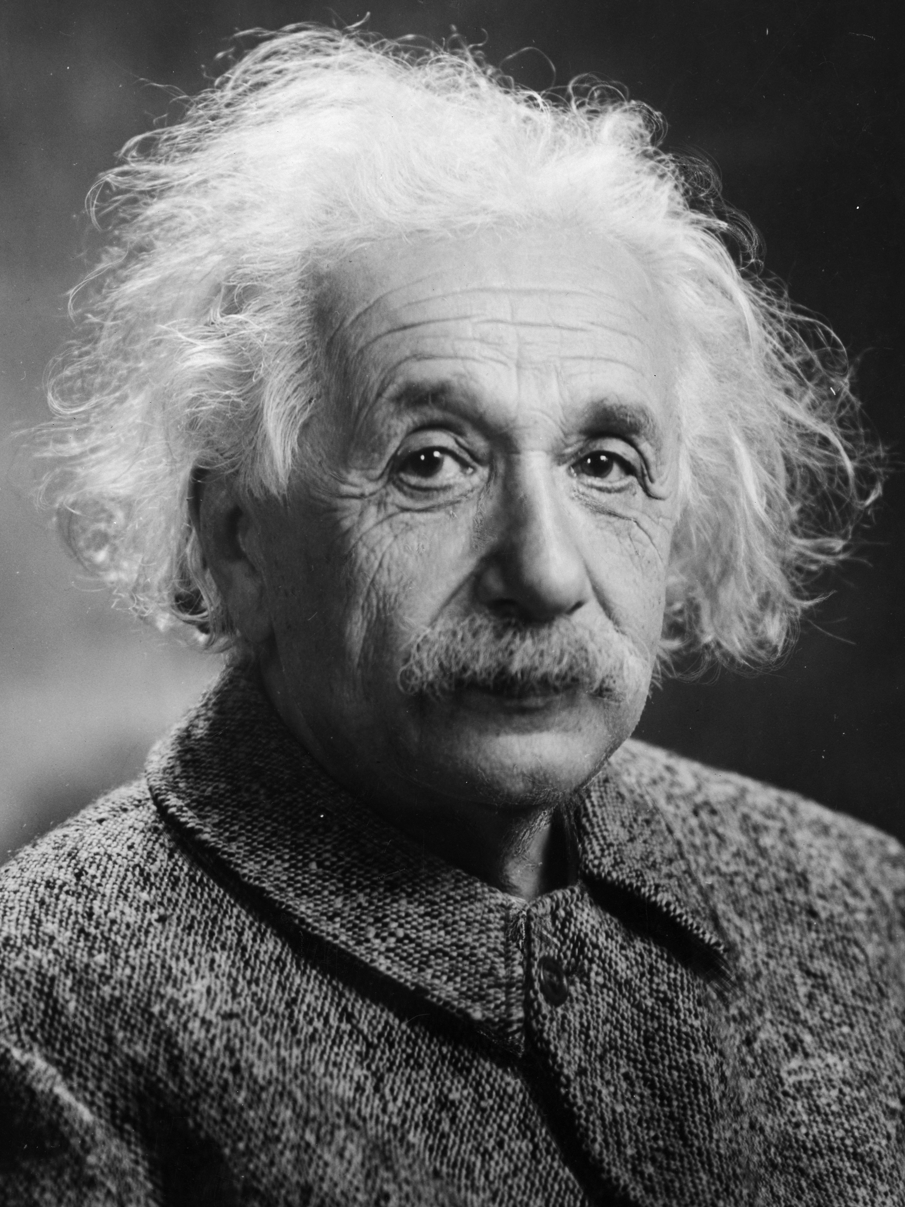
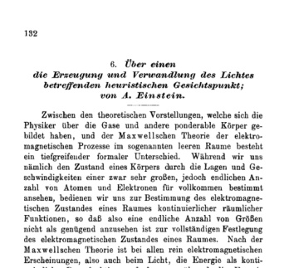
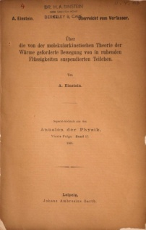
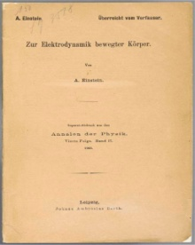
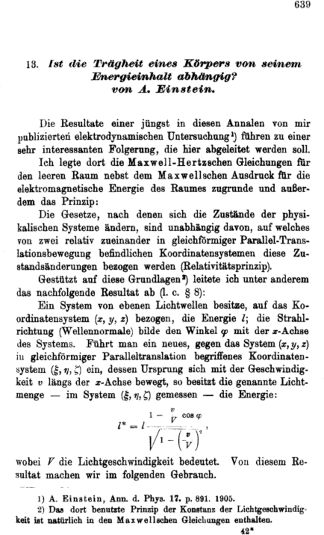
“
“
While it is never safe to affirm that the future of Physical Science has no marvels in store even more astonishing than those of the past, it seems probable that most of the grand underlying principles have been firmly established and that further advances are to be sought chiefly in the rigorous application of these principles to all the phenomena which come under our notice. It is here that the science of measurement shows its importance — where quantitative work is more to be desired than qualitative work. An eminent physicist remarked that the future truths of physical science are to be looked for in the sixth place of decimals.
Albert Michelson | 1894
Annus
Mirabilis
The Year of Miracles
1905
Photoelectric Effect | Special Relativity
Brownian Motion | Mass-Energy Equivalence

Slide 4
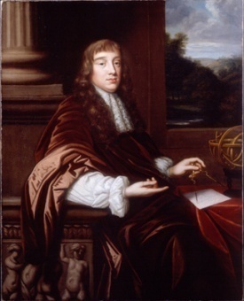
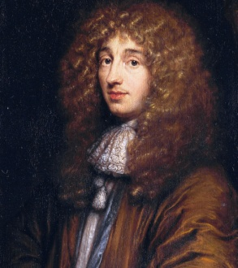
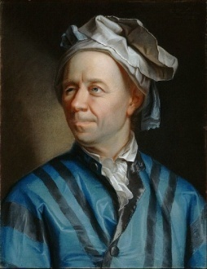

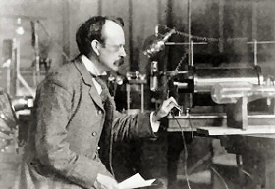
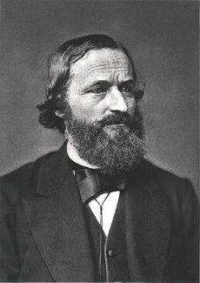
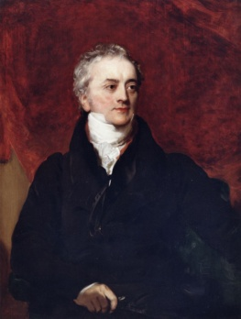
HOOKE
HUYGENS
EULER
Wave Theory of Light
17th and 18th Century
KIRCHOFF | 1859
Double-Slit Interference
Thomas Young, 1803
Cathode Ray
Michael Faraday, 1838
J.J. Thomson, 1897 (electrons)
Radiative Exchange Equilibrium
Statement of Black-Body Radiation
For any material at all, radiating and absorbing in thermodynamic equilibrium at any given temperature T, for every wavelength λ, the ratio of emissive power to absorptivity has one universal value, which is characteristic of a perfect black body, and is an emissive power e.
Kirchoff’s Law of Thermal Radiation

Slide 5
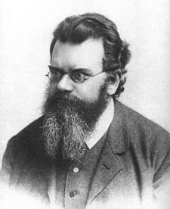
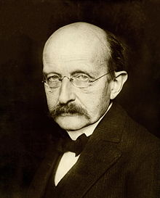
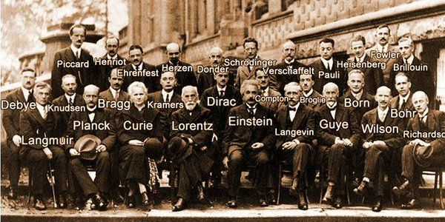
A fundamental principle of quantum mechanics is the postulate that
  the energy of oscillators in a black body is quantized
which was given by Max Planck.
Although Planck focused on (virtual) oscillators in the black-body, Einstein later postulated that the energy of the photons itself is quantized.
Energy states can be discrete
Ludwig Boltzmann, 1877
Max
Planck
1900
Solvay Conference
1927

Slide 6
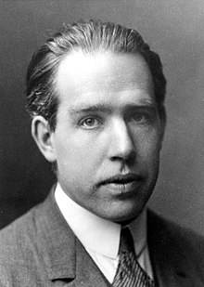
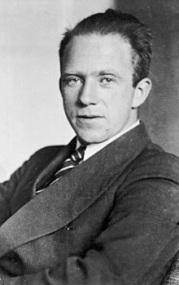
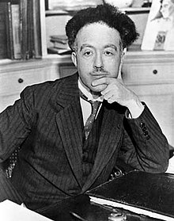
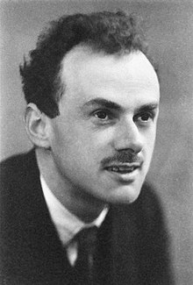
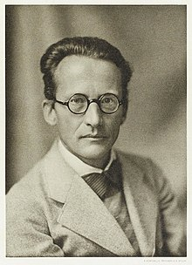
“
“
It seems as though we must use sometimes the one theory and sometimes the other, while at times we may use either. We are faced with a new kind of difficulty. We have two contradictory pictures of reality; separately neither of them fully explains the phenomena of light, but together they do.
Albert Einstein
Bohr Model, Complementarity, Correspondence Principle
Neils
BOHR
Heisenberg Uncertainty Principle, Matrix Formulation
Werner HEISENBERG
Wave-Particle Duality
(Momentum and Wavelength)
Louis
DE BROGLIE
Quantized Gravity,
Dirac Equation, Fermi-Dirac Statistics
Paul
DIRAC
Schrödinger equation,
Dynamical
evolution
Erwin
SCHRÖDINGER

Slide 7
What is Quantum Mechanics?
Classical mechanics describes objects with precise positions and velocities, but quantum mechanics replaces this certainty with a probabilistic framework where states evolve according to a wavefunction.
At atomic and subatomic scales, particles such as electrons and photons exhibit interference and diffraction, phenomena that are characteristic of waves rather than classical particles.
A quantum system can exist in a superposition of multiple states until a measurement forces it into one definite outcome, as described by the Born rule and wavefunction collapse.
The quantization of energy levels and electron behavior in atoms underpins modern technologies such as semiconductor-based transistors, laser physics, and emerging quantum computing paradigms.
Quantum mechanics reveals nonlocal correlations (entanglement), uncertainty in simultaneous measurements (Heisenberg's principle), and the absence of absolute reality before observation, challenging classical notions of an objective universe.

Slide 8
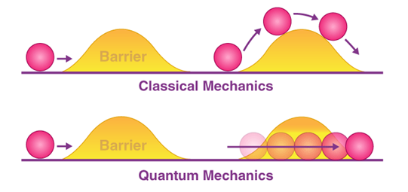
Quantum Tunnelling through Barriers

Slide 9


Slide 10
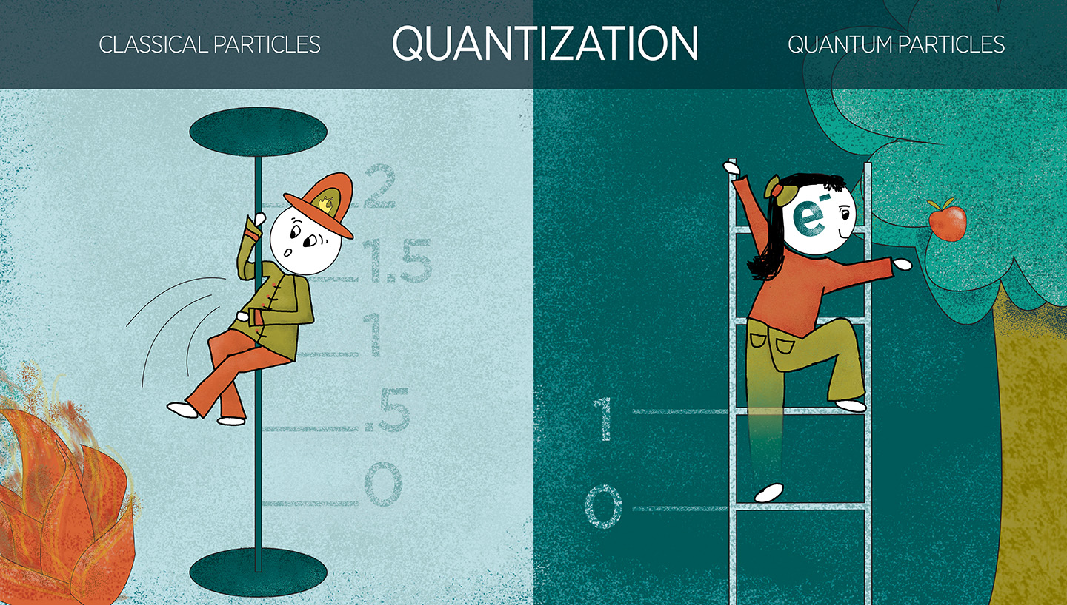
Credit: N. Hanacek / NIST

Slide 11


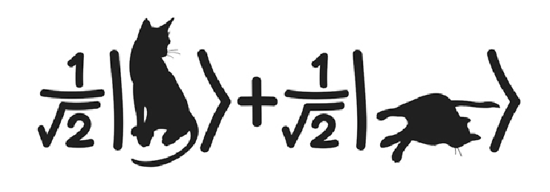

Reality
and Role of Wavefunction Collapse
Non-Locality
and Entanglement
Credit: N. Hanacek / NIST

Slide 12
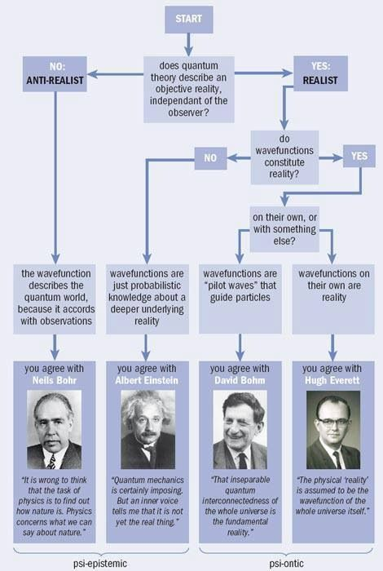
Interpretations of
Quantum Mechanics

Slide 13
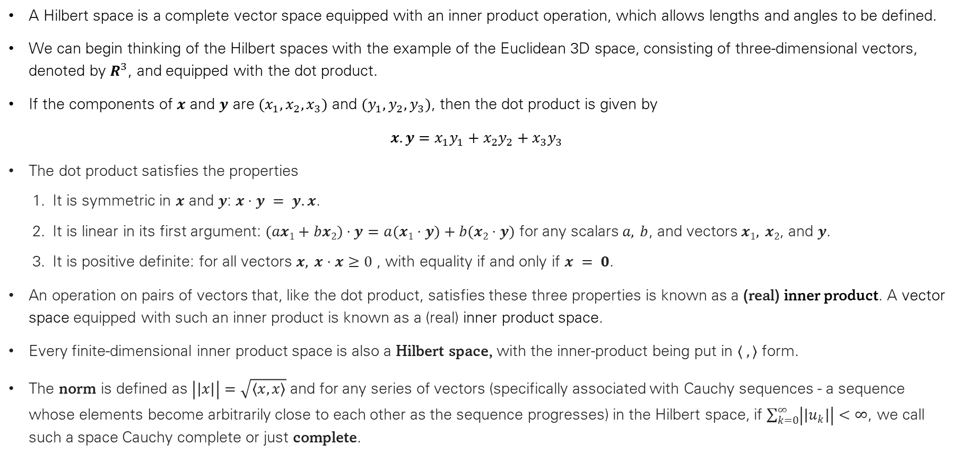
Hilbert Spaces
A Hilbert space is a complete vector space equipped with an inner product operation, which allows lengths and angles to be defined.
We can begin thinking of the Hilbert spaces with the example of the Euclidean 3D space, consisting of three-dimensional vectors, denoted by $R^{3}$, and equipped with the dot product.
If the components of $x$ and $y$ are $(x_{1}, x_{2}, x_{3})$ and $(y_{1},y_{2},y_{3})$, then the dot product is given by
$x.y=x_{1}y_{1}+x_{2}y_{2}+x_{3}y_{3}$
The dot product satisfies the properties
  It is symmetric in $x$ and $y$: $x⋅y = y.x$.
  It is linear in its first argument: $(ax1+bx2)⋅y=a(x1⋅y)+b(x2⋅y)$ for any scalars $a, b$, and vectors $x1, x2$, and $y$.
  It is positive definite: for all vectors $x, x⋅x≥0$ , with equality if and only if $x = 0$.
An operation on pairs of vectors that, like the dot product, satisfies these three properties is known as a (real) inner product. A vector space equipped with such an inner product is known as a (real) inner product space.
Every finite-dimensional inner product space is also a Hilbert space, with the inner-product being put in $⟨ , ⟩$ form.
The norm is defined as $\left|\left|x\right|\right|=\sqrt{\left\langle x,x\right\rangle }$ and for any series of vectors (specifically associated with Cauchy sequences - a sequence whose elements become arbitrarily close to each other as the sequence progresses) in the Hilbert space, if $\sum_{k=0}^{∞}{\left|\left|u_{k}\right|\right|<∞}$, we call such a space Cauchy complete or just complete.

Slide 14
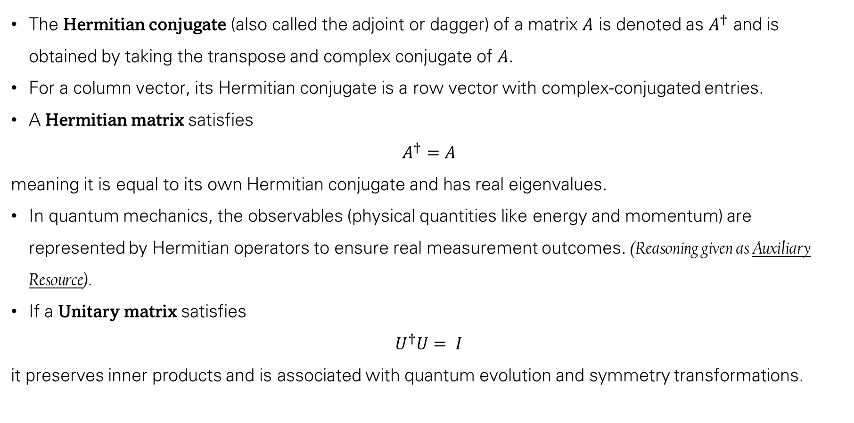
Hermitian Conjugate, Hermitian Matrices and Unitarity
The Hermitian conjugate (also called the adjoint or dagger) of a matrix $A$ is denoted as $A^{†}$ and is obtained by taking the transpose and complex conjugate of $A$.
For a column vector, its Hermitian conjugate is a row vector with complex-conjugated entries.
A Hermitian matrix satisfies
$$A^{†}=A$$
meaning it is equal to its own Hermitian conjugate and has real eigenvalues.
In quantum mechanics, the observables (physical quantities like energy and momentum) are represented by Hermitian operators to ensure real measurement outcomes. (Reasoning given as Auxiliary Resource).
If a Unitary matrix satisfies
$$U^{†}U= I$$
it preserves inner products and is associated with quantum evolution and symmetry transformations.

Slide 15
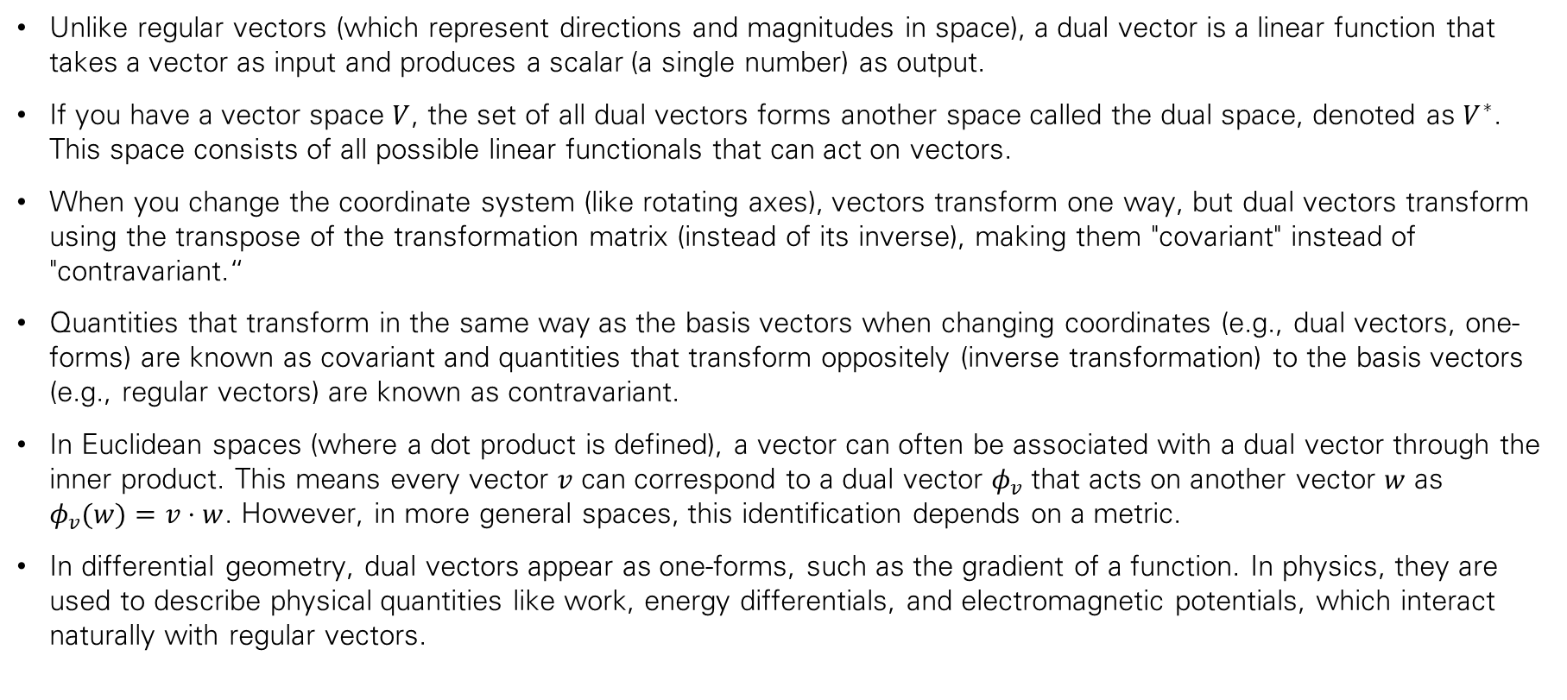
Dual Vectors
Unlike regular vectors (which represent directions and magnitudes in space), a dual vector is a linear function that takes a vector as input and produces a scalar (a single number) as output.
If you have a vector space $V$, the set of all dual vectors forms another space called the dual space, denoted as $V^{∗}$. This space consists of all possible linear functionals that can act on vectors.
When you change the coordinate system (like rotating axes), vectors transform one way, but dual vectors transform using the transpose of the transformation matrix (instead of its inverse), making them "covariant" instead of "contravariant.“
Quantities that transform in the same way as the basis vectors when changing coordinates (e.g., dual vectors, one-forms) are known as covariant and quantities that transform oppositely (inverse transformation) to the basis vectors (e.g., regular vectors) are known as contravariant.
In Euclidean spaces (where a dot product is defined), a vector can often be associated with a dual vector through the inner product. This means every vector $v$ can correspond to a dual vector $φ_{v}$​ that acts on another vector $w$ as $φ_{v}(w)=v⋅w$. However, in more general spaces, this identification depends on a metric.
In differential geometry, dual vectors appear as one-forms, such as the gradient of a function. In physics, they are used to describe physical quantities like work, energy differentials, and electromagnetic potentials, which interact naturally with regular vectors.

Slide 16
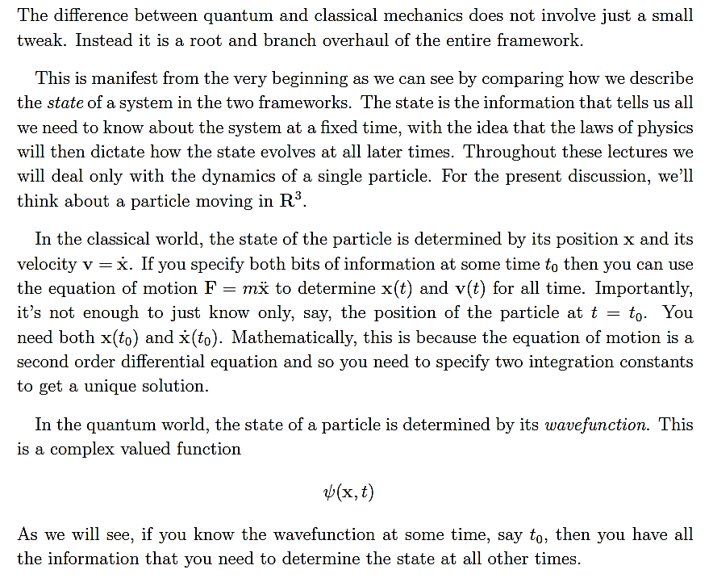
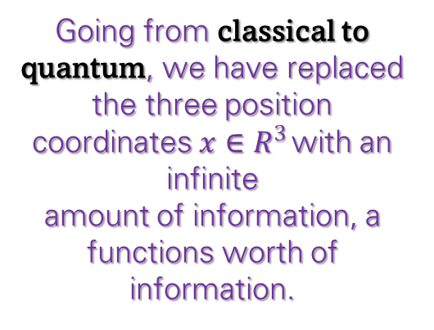
Going from classical to quantum, we have replaced the three position coordinates $x∈R^{3}$ with an infinite
amount of information, a functions worth of information.

Slide 17
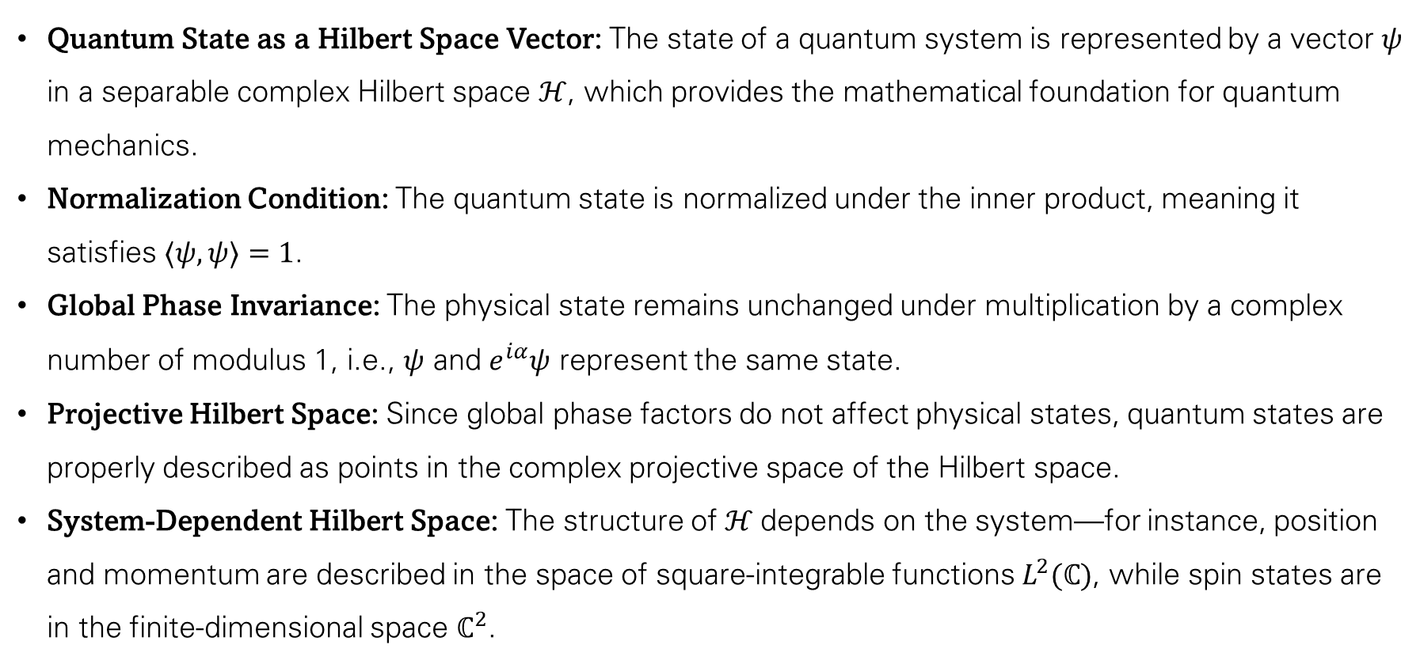
Quantum States
Quantum State as a Hilbert Space Vector: The state of a quantum system is represented by a vector $ψ$ in a separable complex Hilbert space $ℋ$, which provides the mathematical foundation for quantum mechanics.
Normalization Condition: The quantum state is normalized under the inner product, meaning it satisfies $⟨ψ,ψ⟩=1$.
Global Phase Invariance: The physical state remains unchanged under multiplication by a complex number of modulus 1, i.e., $ψ$ and $e^{iα}ψ$ represent the same state.
Projective Hilbert Space: Since global phase factors do not affect physical states, quantum states are properly described as points in the complex projective space of the Hilbert space.
System-Dependent Hilbert Space: The structure of $ℋ$depends on the system—for instance, position and momentum are described in the space of square-integrable functions $L^{2}(ℂ)$, while spin states are in the finite-dimensional space $ℂ^{2}$.

Slide 18
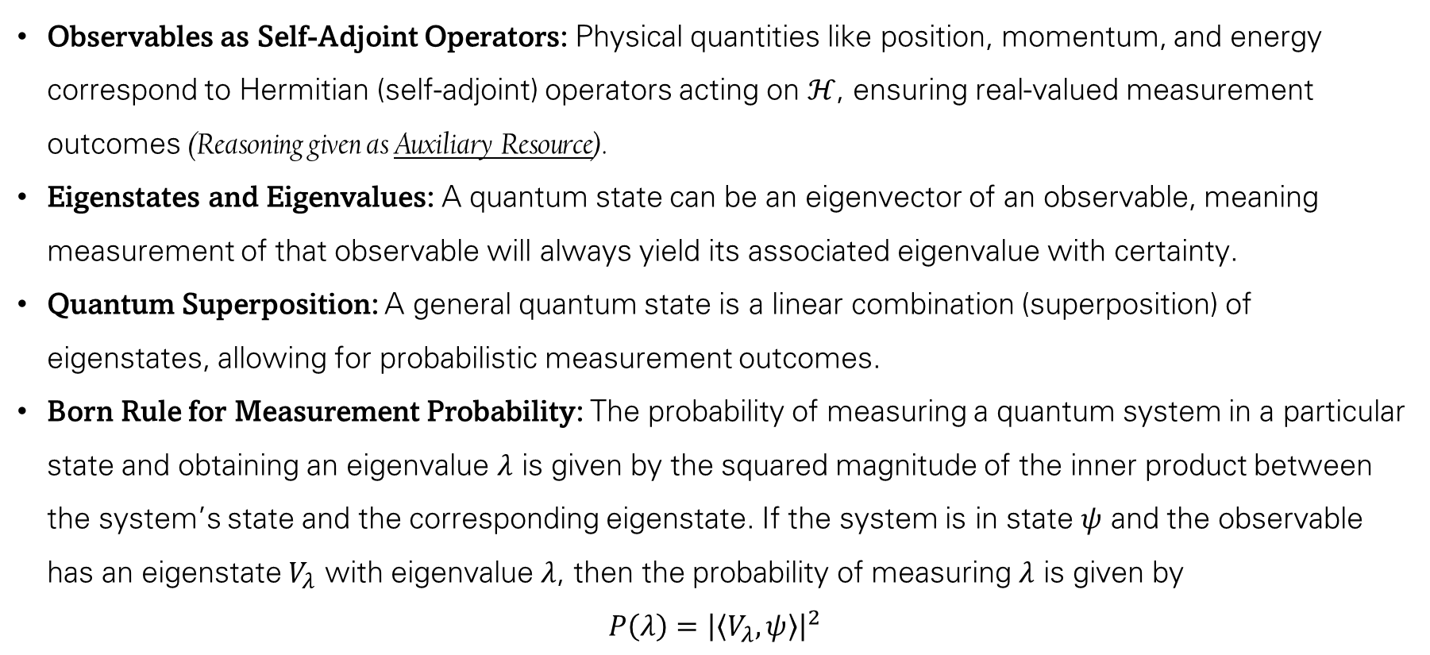
Observables, Eigensystems and Born Rule
Observables as Self-Adjoint Operators: Physical quantities like position, momentum, and energy correspond to Hermitian (self-adjoint) operators acting on $ℋ$, ensuring real-valued measurement outcomes (Reasoning given as Auxiliary Resource).
Eigenstates and Eigenvalues: A quantum state can be an eigenvector of an observable, meaning measurement of that observable will always yield its associated eigenvalue with certainty.
Quantum Superposition: A general quantum state is a linear combination (superposition) of eigenstates, allowing for probabilistic measurement outcomes.
Born Rule for Measurement Probability: The probability of measuring a quantum system in a particular state and obtaining an eigenvalue $λ$ is given by the squared magnitude of the inner product between the system’s state and the corresponding eigenstate. If the system is in state $ψ$ and the observable has an eigenstate $V_{λ}$ with eigenvalue $λ$, then the probability of measuring $λ$ is given by
$$P\left(λ\right)={\left|\left\langle V_{λ},ψ\right\rangle \right|}^{2}$$

Slide 19
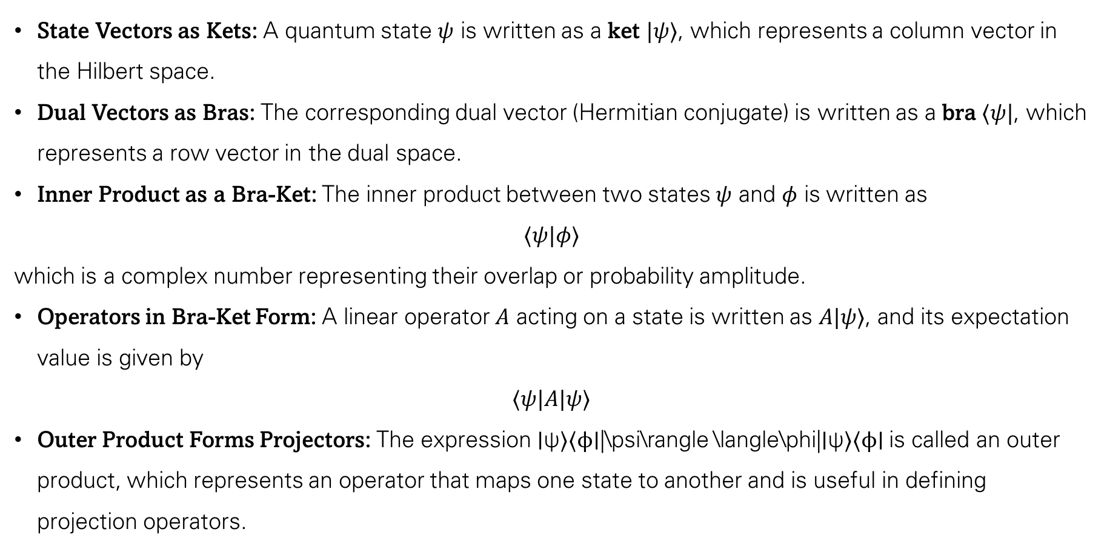
Bra-Ket Notation
State Vectors as Kets: A quantum state $ψ$ is written as a ket $|ψ⟩$, which represents a column vector in the Hilbert space.
Dual Vectors as Bras: The corresponding dual vector (Hermitian conjugate) is written as a bra $⟨ψ|$, which represents a row vector in the dual space.
Inner Product as a Bra-Ket: The inner product between two states $ψ$ and $φ$ is written as
$$⟨ψ|φ⟩$$
which is a complex number representing their overlap or probability amplitude.
Operators in Bra-Ket Form: A linear operator $A$ acting on a state is written as $A|ψ⟩$, and its expectation value is given by
$$⟨ψ|A|ψ⟩$$
Outer Product Forms Projectors: The expression ∣ψ⟩⟨ϕ∣|\psi\rangle \langle\phi|∣ψ⟩⟨ϕ∣ is called an outer product, which represents an operator that maps one state to another and is useful in defining projection operators.

Slide 20
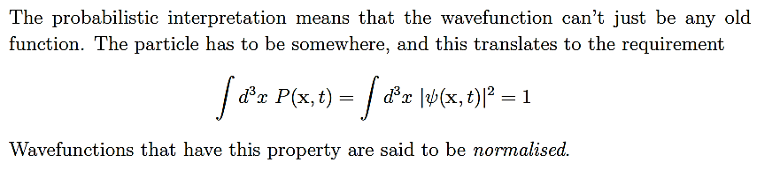
Normalization Condition

Slide 21
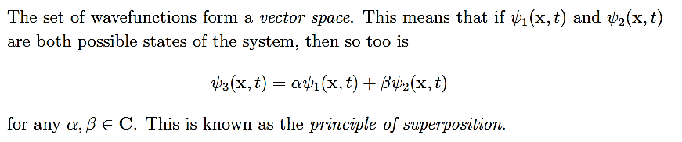
Principle of Superposition

Slide 22
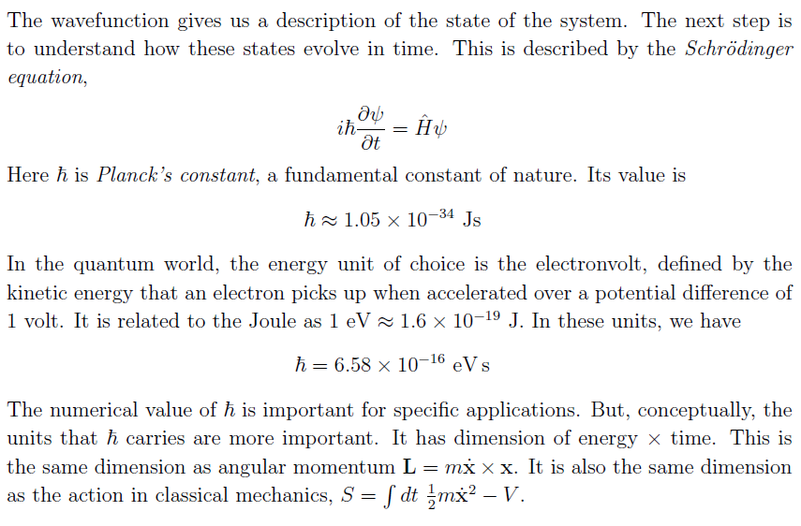
Schrödinger’s Equation

Slide 23
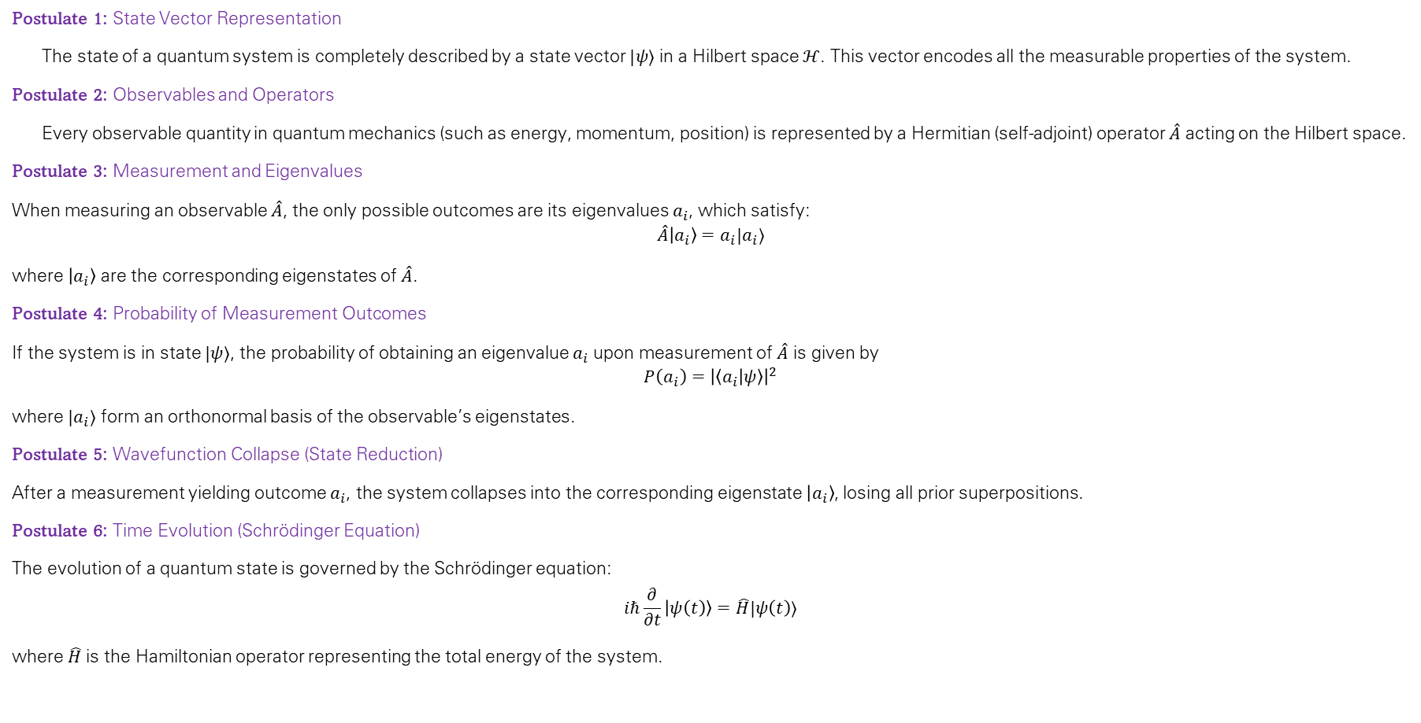
Postulates of Quantum Mechanics
Postulate 1: State Vector Representation
The state of a quantum system is completely described by a state vector $|ψ⟩$ in a Hilbert space $ℋ$. This vector encodes all the measurable properties of the system.
Postulate 2: Observables and Operators
Every observable quantity in quantum mechanics (such as energy, momentum, position) is represented by a Hermitian (self-adjoint) operator $\hat{A}$ acting on the Hilbert space.
Postulate 3: Measurement and Eigenvalues
When measuring an observable $\hat{A}$, the only possible outcomes are its eigenvalues $a_{i}$​, which satisfy:
$$\hat{A}\left|a_{i}\right\rangle =a_{i}|a_{i}⟩$$
where $\left|a_{i}\right\rangle$ are the corresponding eigenstates of $\hat{A}$.
Postulate 4: Probability of Measurement Outcomes
If the system is in state $|ψ⟩$, the probability of obtaining an eigenvalue $a_{i}$​ upon measurement of $\hat{A}$ is given by
$$P\left(a_{i}\right)={\left|\left\langle a_{i} | ψ\right\rangle \right|}^{2}$$
where $|a_{i}⟩$ form an orthonormal basis of the observable’s eigenstates.
Postulate 5: Wavefunction Collapse (State Reduction)
After a measurement yielding outcome $a_{i}$​, the system collapses into the corresponding eigenstate $\left|a_{i}\right\rangle$, losing all prior superpositions.
Postulate 6: Time Evolution (Schrödinger Equation)
The evolution of a quantum state is governed by the Schrödinger equation:
$$iℏ\frac{∂}{∂t}\left|ψ\left(t\right)\right\rangle =\hat{H}|ψ\left(t\right)⟩$$
where $\hat{H}$ is the Hamiltonian operator representing the total energy of the system.

Slide 24
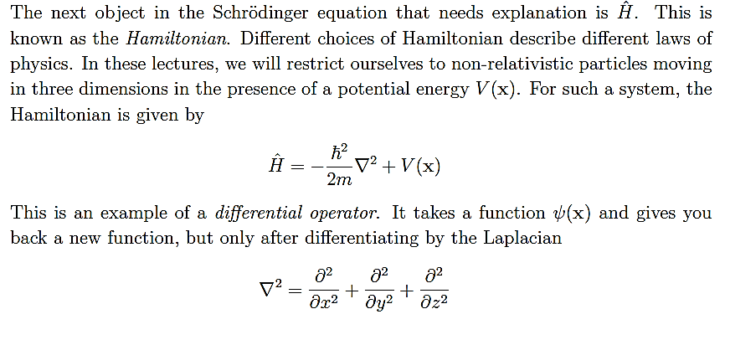
Hamiltonian

Slide 25
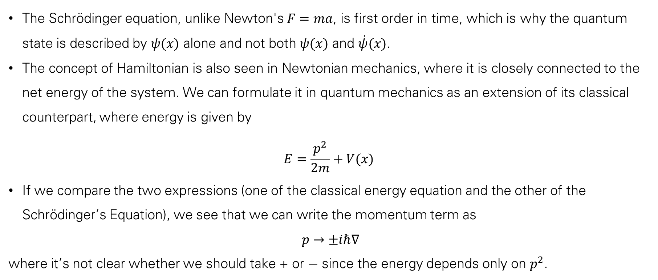
Comments regarding Schrödinger’s Equation
The Schrödinger equation, unlike Newton's $F=ma$, is first order in time, which is why the quantum state is described by $ψ(x)$ alone and not both $ψ(x)$ and $\dot{ψ}(x)$.
The concept of Hamiltonian is also seen in Newtonian mechanics, where it is closely connected to the net energy of the system. We can formulate it in quantum mechanics as an extension of its classical counterpart, where energy is given by
$$E=\frac{p^{2}}{2m}+V(x)$$
If we compare the two expressions (one of the classical energy equation and the other of the Schrödinger’s Equation), we see that we can write the momentum term as
$$p→±iℏ∇$$
where it’s not clear whether we should take + or − since the energy depends only on $p^{2}$.

Slide 26
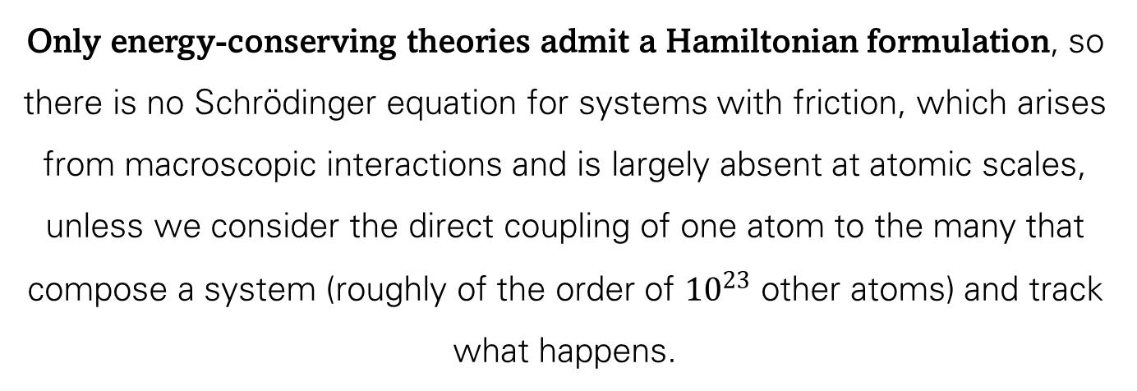
Only energy-conserving theories admit a Hamiltonian formulation, so there is no Schrödinger equation for systems with friction, which arises from macroscopic interactions and is largely absent at atomic scales, unless we consider the direct coupling of one atom to the many that compose a system (roughly of the order of ${10}^{23}$ other atoms) and track what happens.

Slide 27
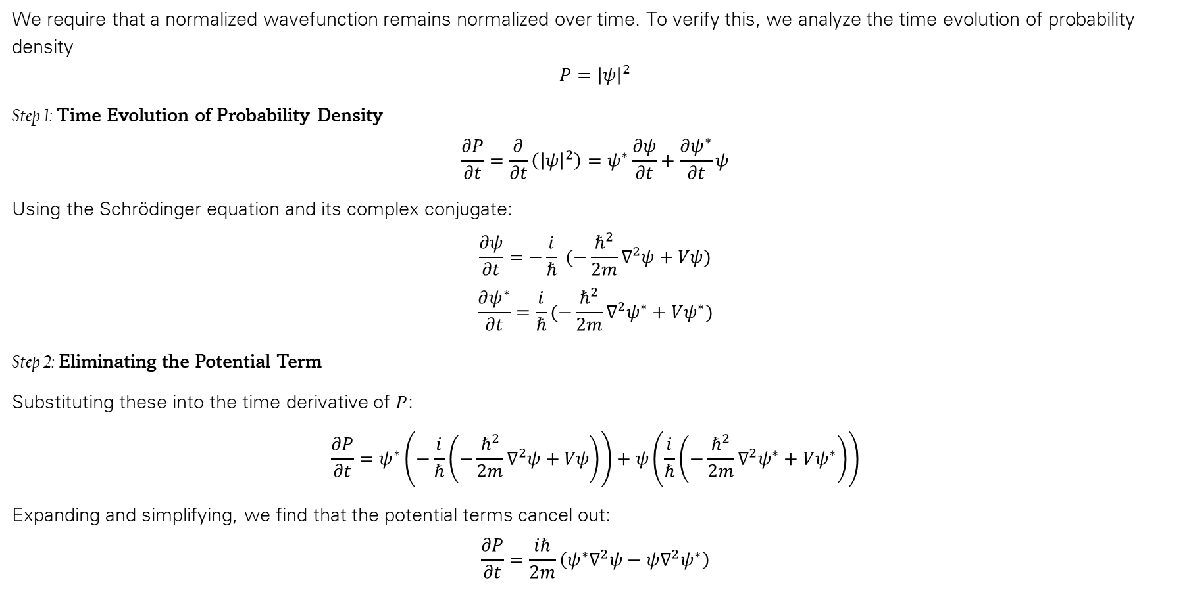
Conservation of Probability in Quantum Mechanics
We require that a normalized wavefunction remains normalized over time. To verify this, we analyze the time evolution of probability density
$$P={\left|ψ\right|}^{2}$$
Step 1: Time Evolution of Probability Density
$$\frac{∂P}{∂t}=\frac{∂}{∂t}\left({\left|ψ\right|}^{2}\right)=ψ^{∗}\frac{∂ψ}{∂t}+\frac{∂ψ^{∗}}{∂t}ψ$$
Using the Schrödinger equation and its complex conjugate:
$$\frac{∂ψ}{∂t}=−\frac{i}{ℏ} (−\frac{ℏ^{2}}{2m}∇^{2}ψ+Vψ)$$
$$\frac{∂ψ^{∗}}{∂t}=\frac{i}{ℏ}(−\frac{ℏ^{2}}{2m}∇^{2}ψ^{∗}+Vψ^{∗})$$
Step 2: Eliminating the Potential Term
Substituting these into the time derivative of $P$:
$$\frac{∂P}{∂t}=ψ^{∗}\left(−\frac{i}{ℏ}\left(−\frac{ℏ^{2}}{2m}∇^{2}ψ+Vψ\right)\right)+ψ\left(\frac{i}{ℏ}\left(−\frac{ℏ^{2}}{2m}∇^{2}ψ^{∗}+Vψ^{∗}\right)\right)$$
Expanding and simplifying, we find that the potential terms cancel out:
$$\frac{∂P}{∂t}=\frac{iℏ}{2m}\left(ψ^{∗}∇^{2}ψ−ψ∇^{2}ψ^{∗}\right)$$

Slide 28
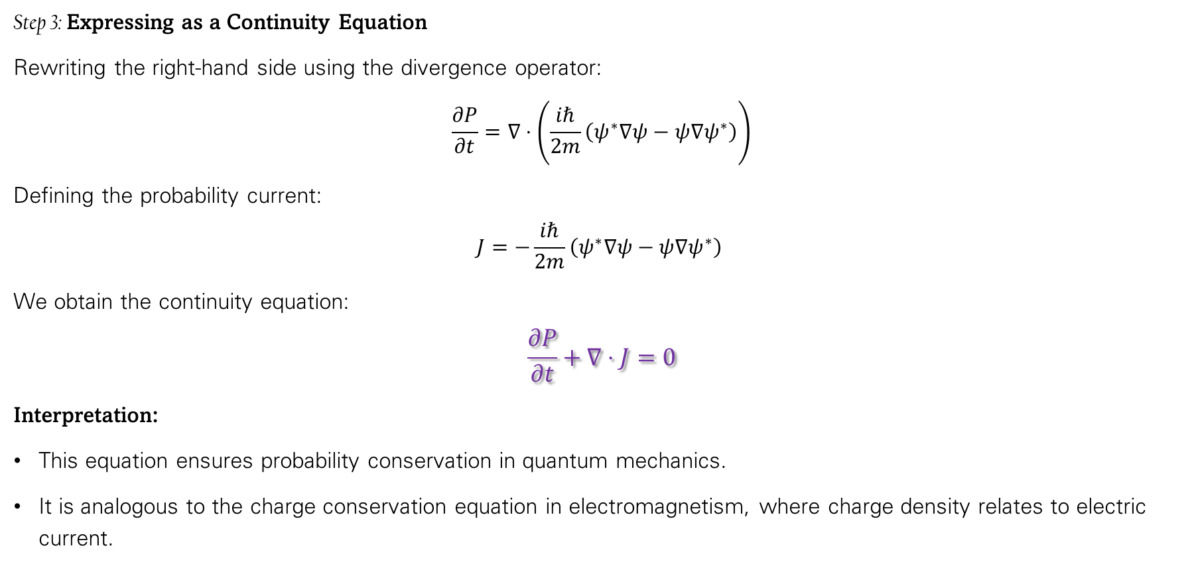
Conservation of Probability in Quantum Mechanics
Step 3: Expressing as a Continuity Equation
Rewriting the right-hand side using the divergence operator:
$$\frac{∂P}{∂t}=∇⋅\left(\frac{iℏ}{2m}\left(ψ^{∗}∇ψ−ψ∇ψ^{∗}\right)\right)$$
Defining the probability current:
$$J=−\frac{iℏ}{2m}\left(ψ^{∗}∇ψ−ψ∇ψ^{∗}\right)$$
We obtain the continuity equation:
$$\frac{∂P}{∂t}+∇⋅J=0$$
Interpretation:
This equation ensures probability conservation in quantum mechanics.
It is analogous to the charge conservation equation in electromagnetism, where charge density relates to electric current.

Slide 29
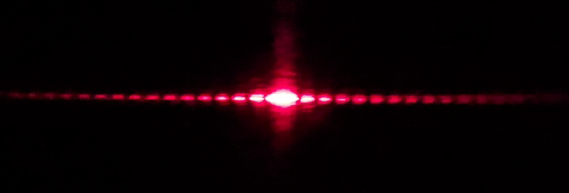
The interference of light waves through a double slit

Slide 30
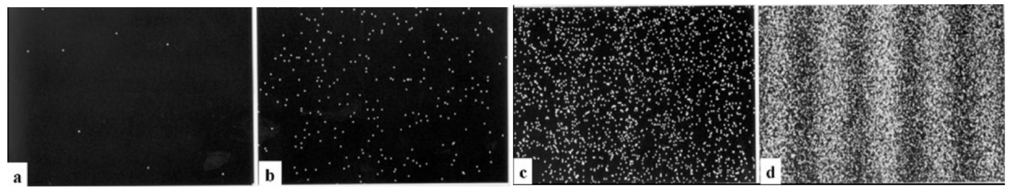
The double slit experiment, performed by Hitachi. The results show the build up the interference pattern from 8 electrons, to 270 electrons, to 2000 electrons and, finally, to 160,000 electrons where the interference fringes are clearly visible

Slide 31
A Quantum Particle in One Dimension

Slide 32
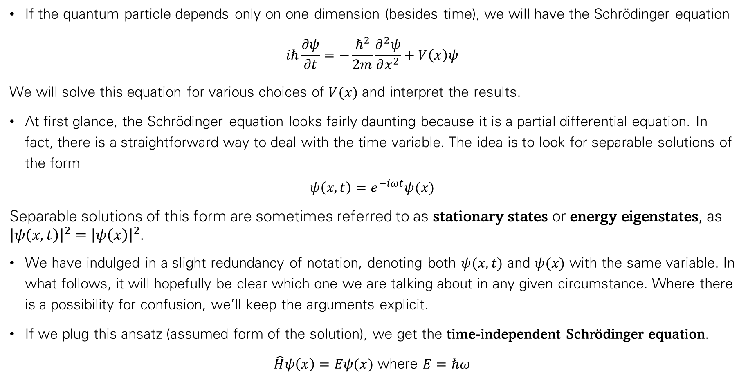
A Quantum Particle in One Dimension
If the quantum particle depends only on one dimension (besides time), we will have the Schrödinger equation
$$iℏ\frac{∂ψ}{∂t}=−\frac{ℏ^{2}}{2m}\frac{∂^{2}ψ}{∂x^{2}}+V\left(x\right)ψ$$
We will solve this equation for various choices of $V(x)$ and interpret the results.
At first glance, the Schrödinger equation looks fairly daunting because it is a partial differential equation. In fact, there is a straightforward way to deal with the time variable. The idea is to look for separable solutions of the form
$$ψ\left(x,t\right)=e^{−iωt}ψ(x)$$
Separable solutions of this form are sometimes referred to as stationary states or energy eigenstates, as ${\left|ψ\left(x,t\right)\right|}^{2}={\left|ψ\left(x\right)\right|}^{2}$.
We have indulged in a slight redundancy of notation, denoting both $ψ(x, t)$ and $ψ(x)$ with the same variable. In what follows, it will hopefully be clear which one we are talking about in any given circumstance. Where there is a possibility for confusion, we’ll keep the arguments explicit.
If we plug this ansatz (assumed form of the solution), we get the time-independent Schrödinger equation.
$\hat{H}ψ\left(x\right)=Eψ(x)$ where $E=ℏω$

Slide 33
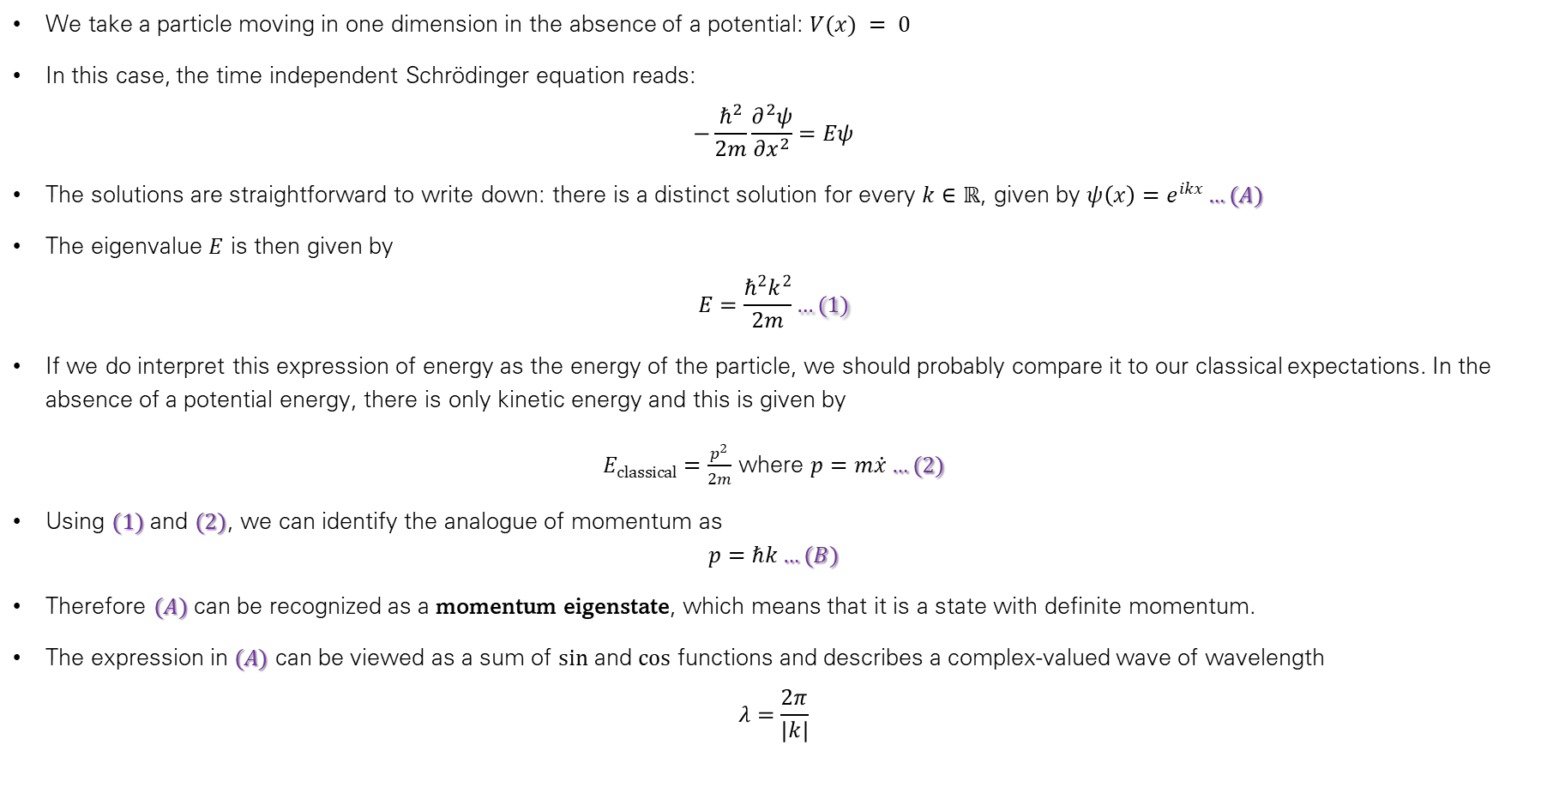
The Free Particle
We take a particle moving in one dimension in the absence of a potential: $V(x) = 0$
In this case, the time independent Schrödinger equation reads:
$$−\frac{ℏ^{2}}{2m}\frac{∂^{2}ψ}{∂x^{2}}=Eψ$$
The solutions are straightforward to write down: there is a distinct solution for every $k∈ℝ$, given by $ψ\left(x\right)=e^{ikx}…(A)$
The eigenvalue $E$ is then given by
$$E=\frac{ℏ^{2}k^{2}}{2m}…(1)$$
If we do interpret this expression of energy as the energy of the particle, we should probably compare it to our classical expectations. In the absence of a potential energy, there is only kinetic energy and this is given by
$E_{classical}=\frac{p^{2}}{2m}$ where $p=m\dot{x}…(2)$
Using $(1)$ and $(2)$, we can identify the analogue of momentum as
$$p=ℏk…(B)$$
Therefore $(A)$ can be recognized as a momentum eigenstate, which means that it is a state with definite momentum.
The expression in $(A)$ can be viewed as a sum of $sin$ and $cos$ functions and describes a complex-valued wave of wavelength
$$λ=\frac{2π}{|k|}$$

Slide 34
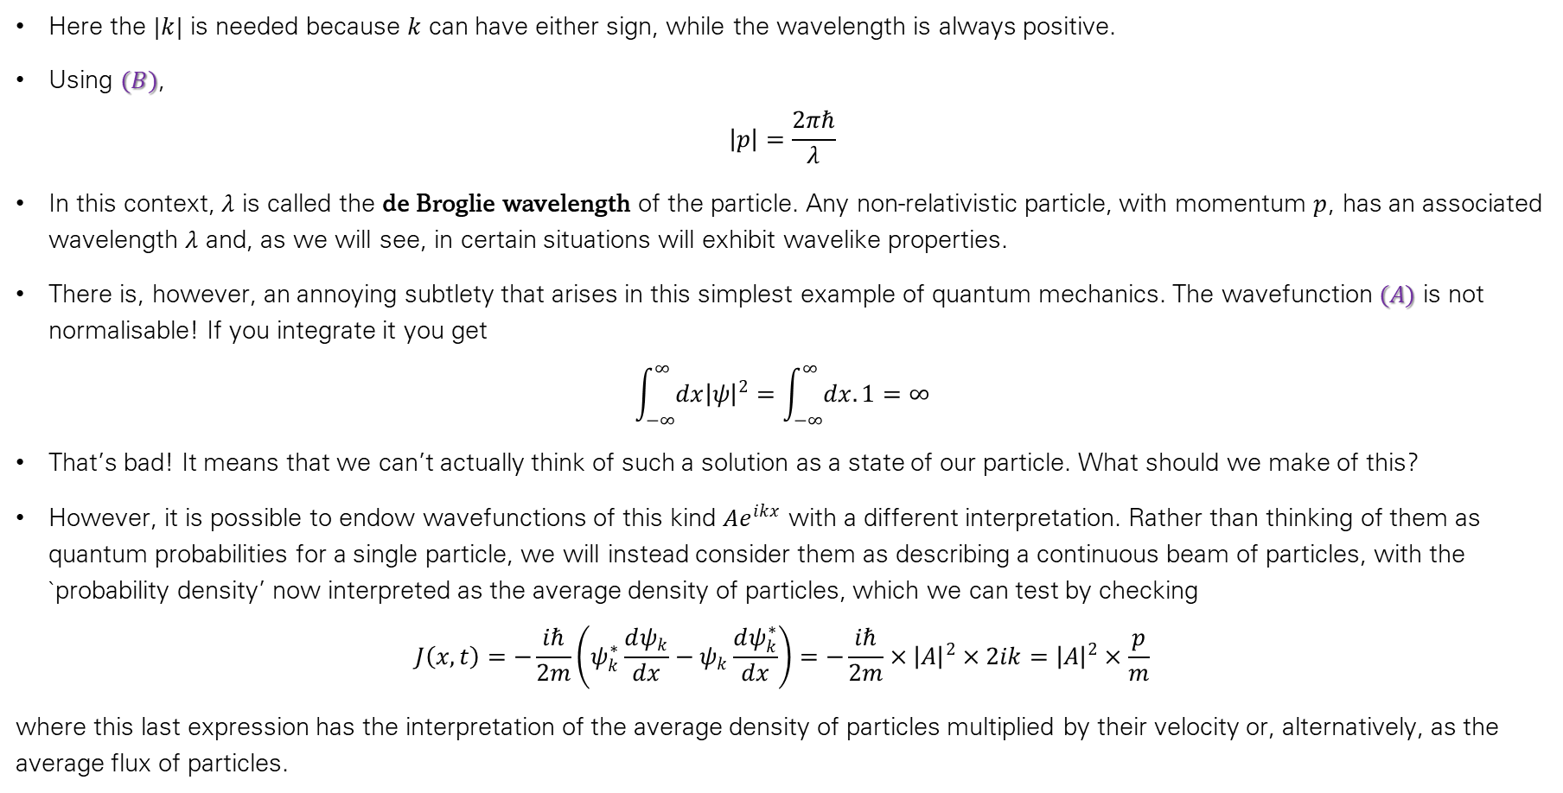
The Free Particle
Here the $|k|$ is needed because $k$ can have either sign, while the wavelength is always positive.
Using $(B)$,
$$\left|p\right|=\frac{2πℏ}{λ}$$
In this context, $λ$ is called the de Broglie wavelength of the particle. Any non-relativistic particle, with momentum $p$, has an associated wavelength $λ$ and, as we will see, in certain situations will exhibit wavelike properties.
There is, however, an annoying subtlety that arises in this simplest example of quantum mechanics. The wavefunction $(A)$ is not normalisable! If you integrate it you get
$$\int_{−∞}^{∞}{dx{\left|ψ\right|}^{2}}=\int_{−∞}^{∞}{dx.1}=∞$$
That’s bad! It means that we can’t actually think of such a solution as a state of our particle. What should we make of this?
However, it is possible to endow wavefunctions of this kind $Ae^{ikx}$ with a different interpretation. Rather than thinking of them as quantum probabilities for a single particle, we will instead consider them as describing a continuous beam of particles, with the `probability density’ now interpreted as the average density of particles, which we can test by checking
$$J\left(x,t\right)=−\frac{iℏ}{2m}\left(ψ_{k}^{∗}\frac{dψ_{k}}{dx}−ψ_{k}\frac{dψ_{k}^{∗}}{dx}\right)=−\frac{iℏ}{2m}×{\left|A\right|}^{2}×2ik={\left|A\right|}^{2}×\frac{p}{m}$$
where this last expression has the interpretation of the average density of particles multiplied by their velocity or, alternatively, as the average flux of particles.

Slide 35
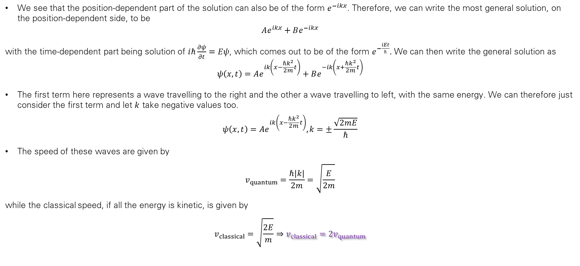
The Free Particle
We see that the position-dependent part of the solution can also be of the form $e^{−ikx}$. Therefore, we can write the most general solution, on the position-dependent side, to be
$$Ae^{ikx}+Be^{−ikx}$$
with the time-dependent part being solution of $iℏ\frac{∂ψ}{∂t}=Eψ$, which comes out to be of the form $e^{−\frac{iEt}{ℏ}}.$ We can then write the general solution as
$$ψ\left(x,t\right)=Ae^{ik\left(x−\frac{ℏk^{2}}{2m}t\right)}+Be^{−ik\left(x+\frac{ℏk^{2}}{2m}t\right)}$$
The first term here represents a wave travelling to the right and the other a wave travelling to left, with the same energy. We can therefore just consider the first term and let $k$ take negative values too.
$$ψ\left(x,t\right)=Ae^{ik\left(x−\frac{ℏk^{2}}{2m}t\right)}, k=±\frac{\sqrt{2mE}}{ℏ}$$
The speed of these waves are given by
$$v_{quantum}=\frac{ℏ|k|}{2m}=\sqrt{\frac{E}{2m}}$$
while the classical speed, if all the energy is kinetic, is given by
$$v_{classical}=\sqrt{\frac{2E}{m}}⇒v_{classical}=2v_{quantum}$$

Slide 36
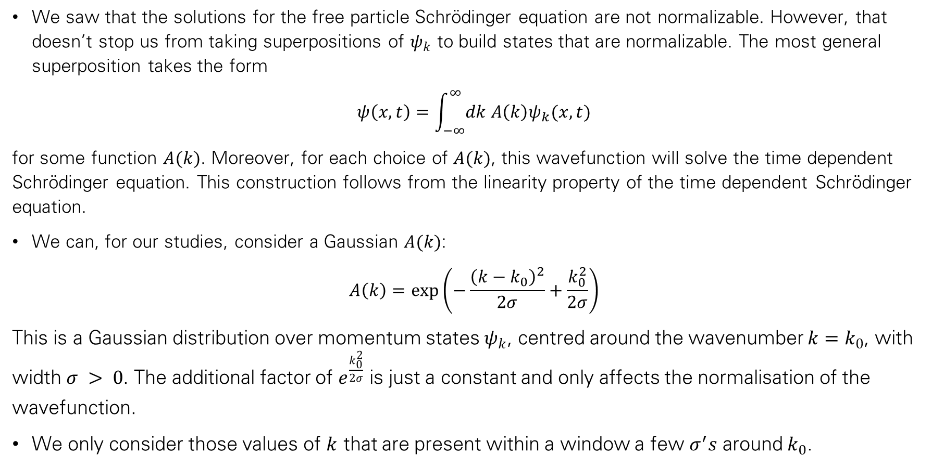
The Free Particle
We saw that the solutions for the free particle Schrödinger equation are not normalizable. However, that doesn’t stop us from taking superpositions of $ψ_{k}$ to build states that are normalizable. The most general superposition takes the form
$$ψ\left(x,t\right)=\int_{−∞}^{∞}{dk A\left(k\right)ψ_{k}(x,t)}$$
for some function $A(k)$. Moreover, for each choice of $A(k)$, this wavefunction will solve the time dependent Schrödinger equation. This construction follows from the linearity property of the time dependent Schrödinger equation.
We can, for our studies, consider a Gaussian $A(k)$:
$$A\left(k\right)=\exp\left(−\frac{{\left(k−k_{0}\right)}^{2}}{2σ}+\frac{k_{0}^{2}}{2σ}\right)$$
This is a Gaussian distribution over momentum states $ψ_{k}$, centred around the wavenumber $k=k_{0}$, with width $σ > 0$. The additional factor of $e^{\frac{k_{0}^{2}}{2σ}}$ is just a constant and only affects the normalisation of the wavefunction.
We only consider those values of $k$ that are present within a window a few $σ^{′}s$ around $k_{0}$.

Slide 37
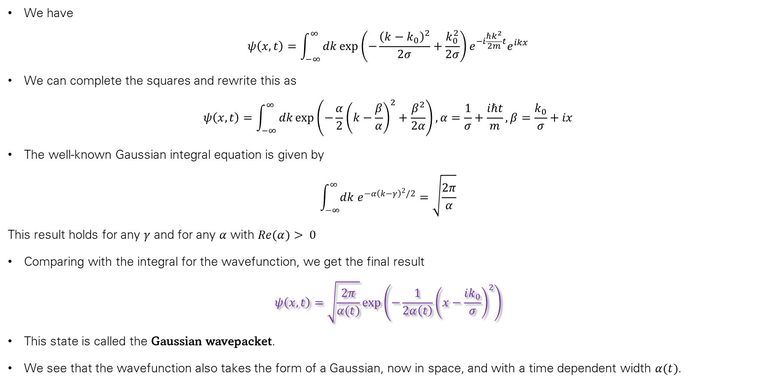
The Free Particle
We have
$$ψ\left(x,t\right)=\int_{−∞}^{∞}{dk\exp\left(−\frac{{\left(k−k_{0}\right)}^{2}}{2σ}+\frac{k_{0}^{2}}{2σ}\right)e^{−i\frac{ℏk^{2}}{2m}t}e^{ikx}}$$
We can complete the squares and rewrite this as
$$ψ\left(x,t\right)=\int_{−∞}^{∞}{dk\exp\left(−\frac{α}{2}{\left(k−\frac{β}{α}\right)}^{2}+\frac{β^{2}}{2α}\right)}, α=\frac{1}{σ}+\frac{iℏt}{m}, β=\frac{k_{0}}{σ}+ix$$
The well-known Gaussian integral equation is given by
$$\int_{−∞}^{∞}{dk e^{−α{\left(k−γ\right)}^{2}/2}}=\sqrt{\frac{2π}{α}}$$
This result holds for any $γ$ and for any $α$ with $Re(α)> 0$
Comparing with the integral for the wavefunction, we get the final result
$$ψ\left(x,t\right)=\sqrt{\frac{2π}{α(t)}}\exp\left(−\frac{1}{2α\left(t\right)}{\left(x−\frac{ik_{0}}{σ}\right)}^{2}\right)$$
This state is called the Gaussian wavepacket.
We see that the wavefunction also takes the form of a Gaussian, now in space, and with a time dependent width $α(t)$.

Slide 38

The Free Particle
This wavefunction is normalizable, though not normalized yet. This follows from the fact that $ψ(x, t)$ decays exponentially quickly as $x → ―∞$. So although we built the wavefunction from the non-normalizable, and hence inadmissible, waves there’s nothing wrong with the end product.
This state has neither definite momentum nor energy nor position. This is actually the lot of most states. Moreover, the state does not take the simple separable form of the stationary states that we’ve discussed until now.
This state is fairly well localized in space. But, as time goes on, it becomes more and more spread out. This is what happens to quantum probability if it is not trapped by some potential: it disperses. It is only the stationary states that have a definite energy and, correspondingly, the simple $e^{−iEt/ℏ}$ time dependence that stick in one place.
Since we built this solution by integrating over momentum modes, we can think of this in terms of the variance, or uncertainty, of the wavenumber which we write as
$$∆k^{2} \sim σ$$
Meanwhile, the spread in position is determined by the function $α(t)$. It is at its minimum when $t = 0$, so we have
$$∆x^{2}\sim α\left(t\right)≥α\left(t=0\right)=\frac{1}{σ}$$
We see that the spread of the wavefunction in position space is inversely proportional to its spread in wavenumber or, equivalently, its spread in momentum $p = ℏk$. Multiplying these together, we get
$$∆x^{2}∆p^{2}≳ℏ^{2}$$
This is the famous Heisenberg Uncertainty Relation. You can localize a particle in space only at the expense of having a broad range of momenta, and vice versa.

Slide 39


Slide 40

Particle in Infinite Potential Well
A particle trapped in an infinite potential well of width $L$ can be studied by considering a potential of the form
$$V\left(x\right)=\left\{\begin{aligned}0, 0<x<L \\ ∞ otherwise\end{aligned} \right.$$
We have the Schrödinger equation
$$iℏ\frac{∂ψ}{∂t}=−\frac{ℏ^{2}}{2m}\frac{∂^{2}ψ}{∂x^{2}}+V\left(x\right)ψ$$
If we’re looking for states with finite energy $E$, then we must have $ψ = 0$ in any region where $V(x)=∞$. Intuitively this is obvious: the infinite potential is just a plot device that allows us to insist that the particle is restricted to lie in the region $0<x<L$. Within this region, we again have our free Schrödinger equation
$$−\frac{ℏ^{2}}{2m}\frac{∂^{2}ψ}{∂x^{2}}=Eψ$$
but now with the restriction that $ψ(x) = 0$ at the two ends of the interval $x = 0$ and $x = L$. The solutions are, once more, a restricted class of the $e^{ikx}$ wavefunctions.
For the particle in the interval, we will consider the more general ansatz $ψ\left(x\right)=Ae^{ikx}+Be^{−ikx}, k>0$.
The requirement that $ψ(x=0)=0$ tells us that $B=−A$, so the wavefunction must be of the form
$$ψ\left(x\right)=A\left(e^{ikx}−e^{−ikx}\right)=2iA\sin{kx}$$
The factor of $2iA$ in front simply changes the normalization of the wavefunction and doesn’t affect the physics.

Slide 41

Particle in Infinite Potential Well
We impose the requirement that the wavefunction vanishes at the other end of the integral, $ψ(x=L)=0$, or
$$\sin{kL}=0⇒k=\frac{nπ}{L}, n∈ℤ^{+}$$
Finally, if we want the wavefunction to be normalized correctly, we should take
$$ψ\left(x\right)=\sqrt{\frac{2}{L}}\sin{kx}$$
In this case, energy is quantized and given by
$$E=\frac{ℏ^{2}n^{2}π^{2}}{2mL^{2}}$$
For the current case, we have (ignoring the normalization) $ψ = e^{ikx}−e^{−ikx}$. This is the superposition of two states, one with momentum $p=+ℏk$ and the other with momentum $p=−ℏk$. This means that these states do not have a well-defined momentum. This shouldn’t be a surprise because a classical particle in a box bounces back and forth and doesn’t have a well-defined sign of the momentum either. Similarly, you can think of the wavefunctions as standing waves, bouncing backwards and forwards between the two walls but not going anywhere.

Slide 42

Lowest Energy of Particle in Infinite Potential Well
The lowest possible energy for the particle (its zero-point energy) is found in state 1, which is given by
$$E=\frac{ℏ^{2}π^{2}}{2mL^{2}}$$
The particle, therefore, always has a positive energy.
This contrasts with classical systems, where the particle can have zero energy by resting motionlessly.
This can be explained in terms of the uncertainty principle, which states that the product of the uncertainties in the position and momentum of a particle is limited by a term dependent on $ℏ$.

Slide 43

Some trajectories of a particle in a box according to Newton's laws of classical mechanics (A), and according to the Schrödinger equation of quantum mechanics (B–F). In (B–F), the horizontal axis is position, and the vertical axis is the real part (blue) and imaginary part (red) of the wave function. The states (B,C,D) are energy eigenstates, but (E,F) are not.

Slide 44

Quantum Tic-Tac-Toe
$$QT^{3}$$

